Slide 1
Deploy node Application on AWS with Kubernetes

Slide 2
Provision Approach
Here I have used Terraform to provision a AWS instance and required infrastructure.
Why Terraform:
Its Open-source provisioning tool.
Helps to create immutable infrastructure irrespective of Vendors
It uses declarative language
And more over doesn’t need any master-slave architecture, its masterless and agentless too.

Slide 3
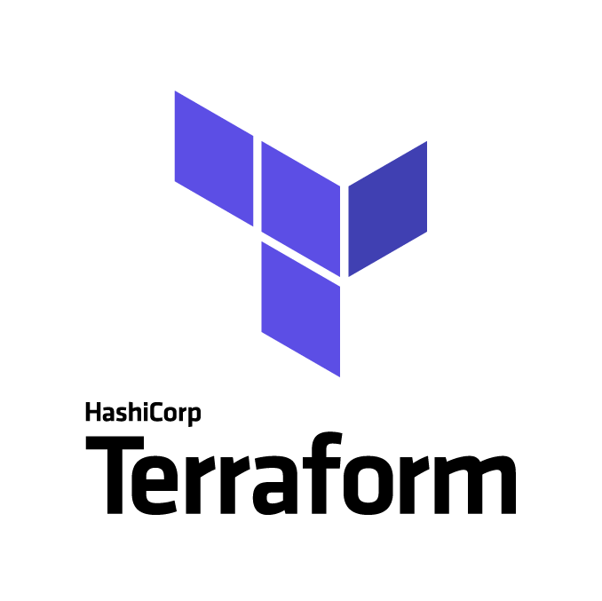
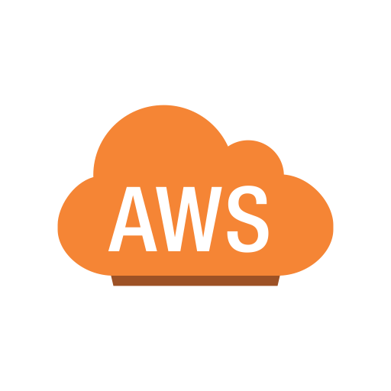
Provisioning

Slide 4
Deployment Approach
Uses AWS infrastructure which created by Terraform
As doesn’t have enough time, kuberenetes deployment made manually using kops and kubelet.
Create two different services called mongo and node.
Node service includes with the GIT URL, which pull the code from the repo and create the image.
If need to deploy any other node application, just replae the GIT URL and port if required, it will deploy it.

Slide 5
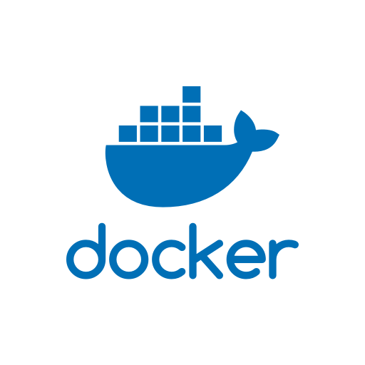
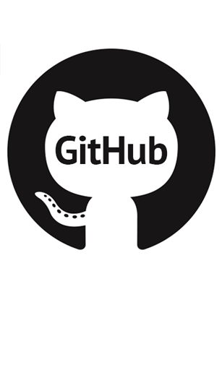
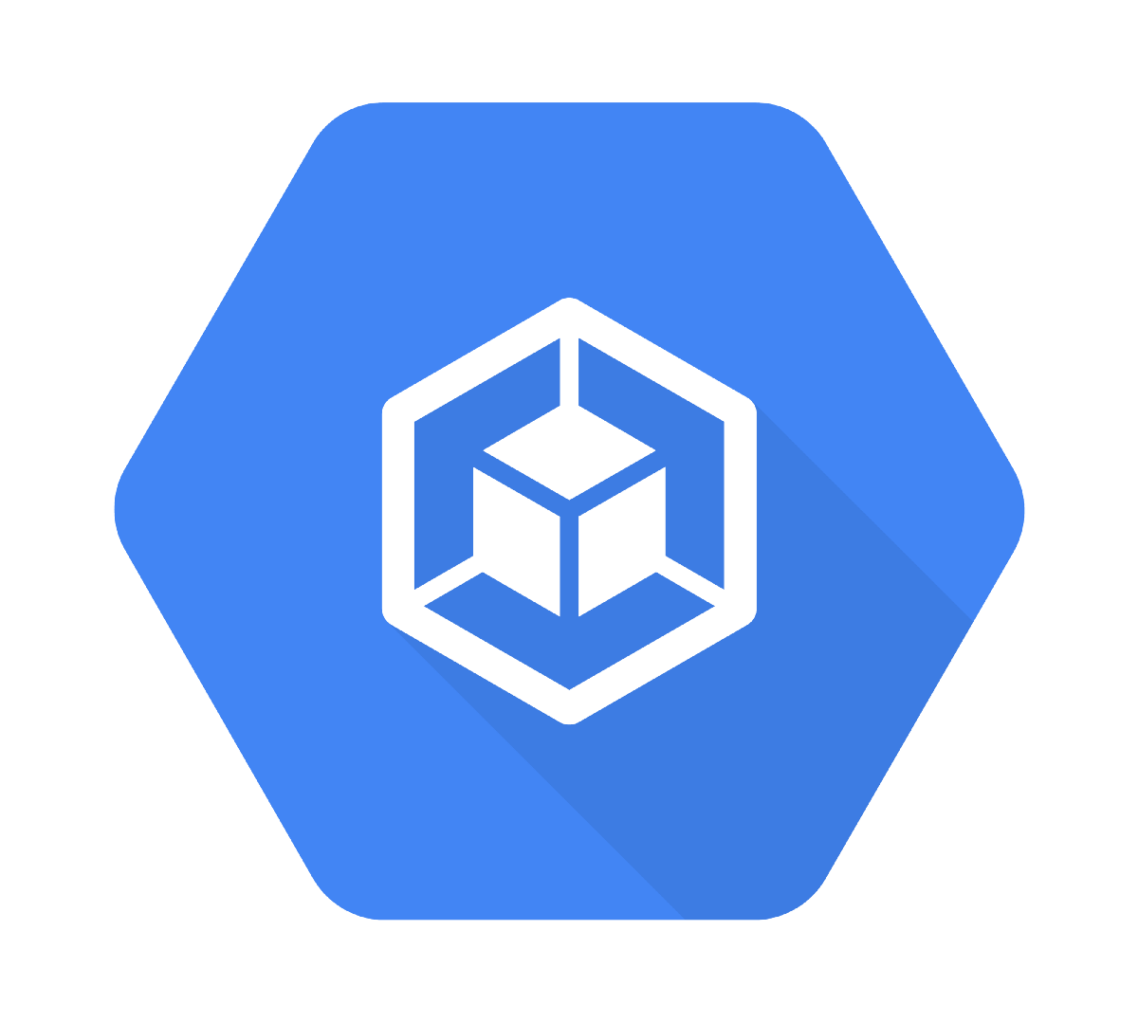
Deployment
Master
node1
node2

Slide 6
Proposal

Slide 7
Proposed Architecture
If got enough time, to create a automated immutable infrastructure, here is the my approach diagram for End-to-End automated immutable infrastructure.
Where it helps?
This is architecture helps to provision a instance/machine across all the cloud include oracle, IBM etc.
Also its suits irrespective of the platform too apart from nodejs, with smaller changes.

Slide 8
